Slide 1


Online NoVaS Conformal Volatility Prediction
Alejandro Canete
ACANETE@UCHICAGO.EDU

Slide 2
Agenda
Context
Problem and Motivation
Proposed method
Experiments and Results
Conclusions and Questions

Slide 3

Context

Slide 4
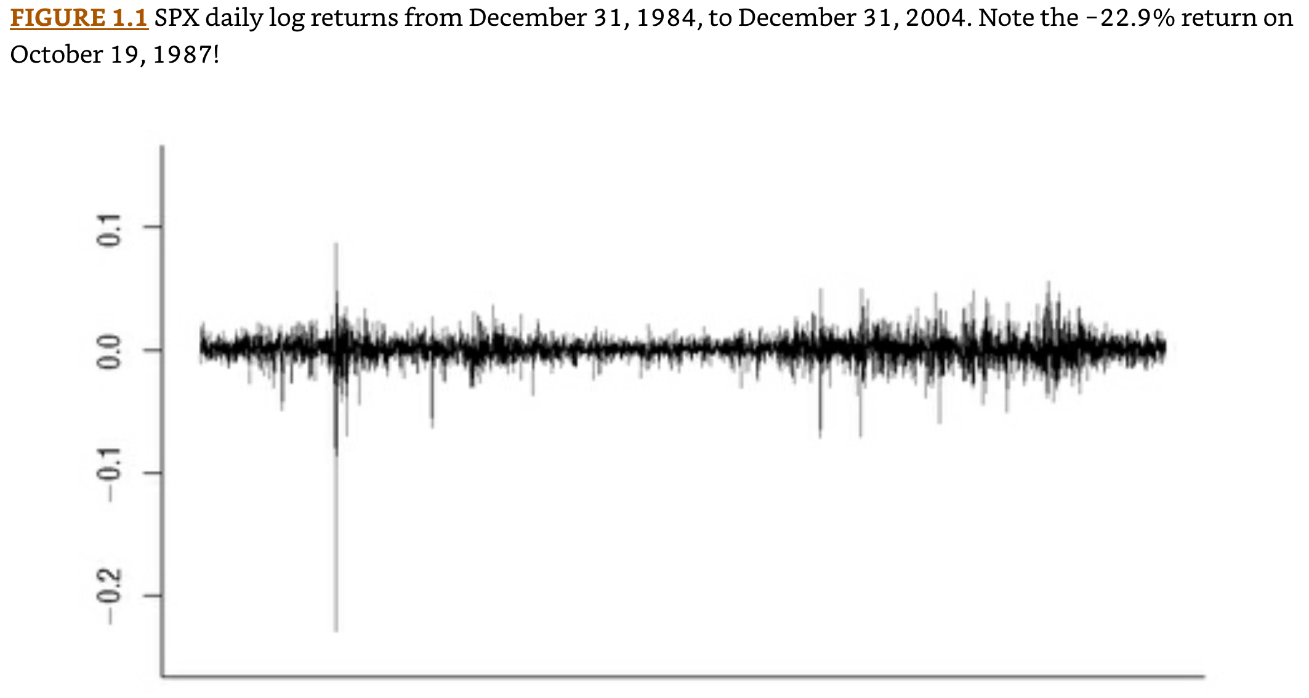
Volatility : The standard deviation of asset returns
Reference: Gatheral, Jim. The volatility surface: a practitioner's guide. John Wiley & Sons, 2011.

Slide 5
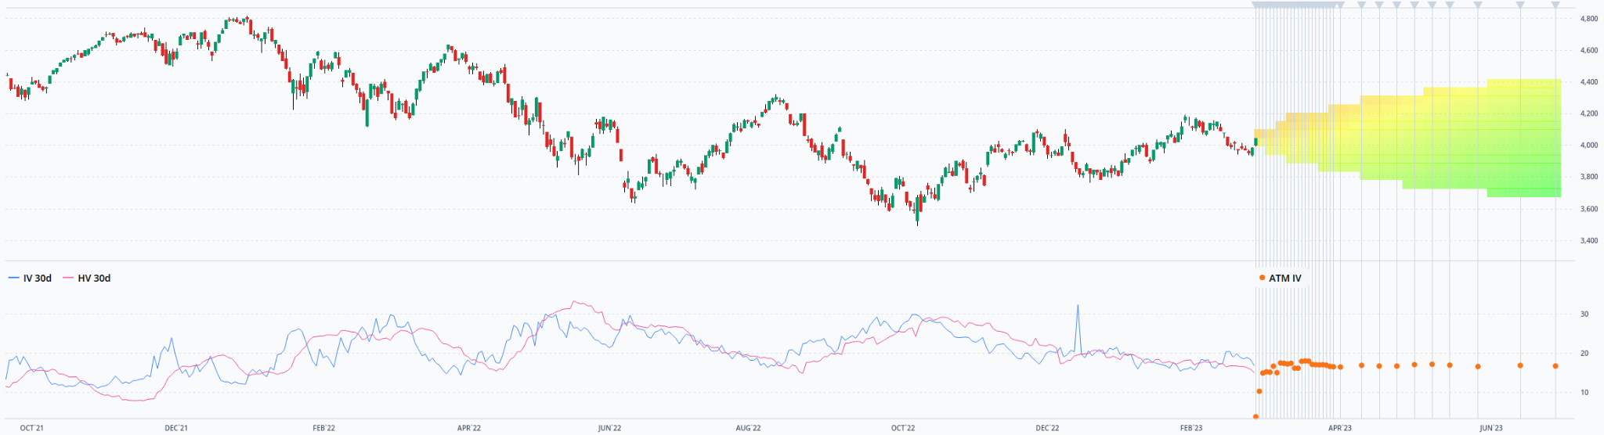
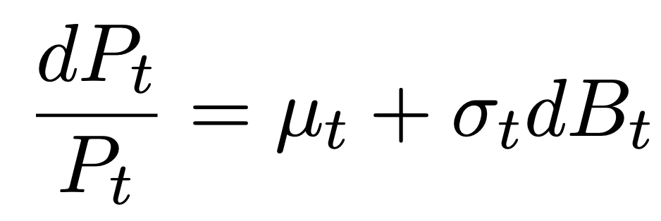
Realized Volatility: “what happened in the past”*
https://dashboard.orats.com/analyzer/tradebuilder
Realized
Expected
“Instantaneous”
*https://www.nasdaq.com/glossary/r/realized-volatility

Slide 6
The Problem and Motivation

Slide 7
The problem
To predict realized volatility
(in a risk aware way)

Slide 8
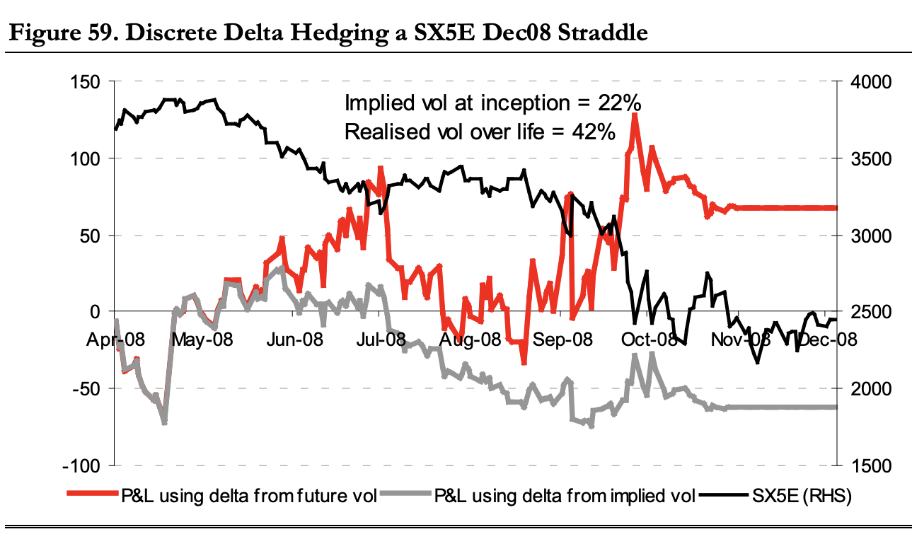

Why? Traders need to predict realized volatility to manage their risks
Delta Hedged Position
Instrument
Delta
Stock Price
Reference: Bennett, Colin, and Miguel A. Gil. "Volatility trading." Trading volatility, Correlation, Term Structure and Skew, Santander Equity Derivatives (2012).

Slide 9
Proposed Method

Slide 10
Executive Summary
We start with an existing realized volatility prediction methodology
Then, given a target error rate for predictive intervals:
We studentize the non-conformity scores using NoVaS
We build predictive intervals under normality
We adjust on-line the significance-level using ACI’s update

Slide 11
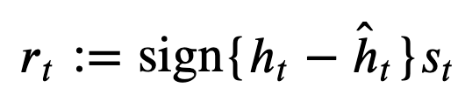
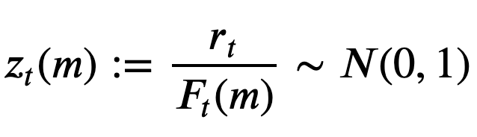
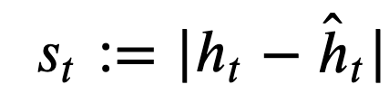
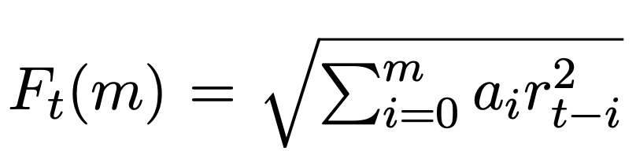

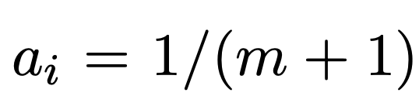
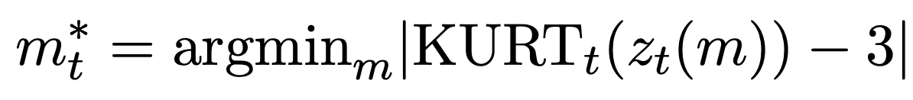
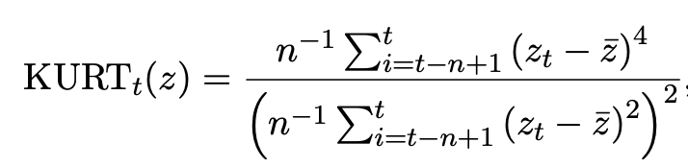
Studentization of non-conformity scores is done by minimizing the empirical excess kurtosis
We first define studentized non-conformity scores
Actual Realized Volatility
Forecasted Volatility
The studentization factor is found by minimizing the excess kurtosis
NoVas: Dimitris N Politis and Dimitrios D Thomakos. NoVaS transformations: flexible inference for volatility forecasting. Springer, 2013.

Slide 12
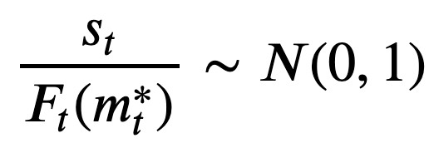
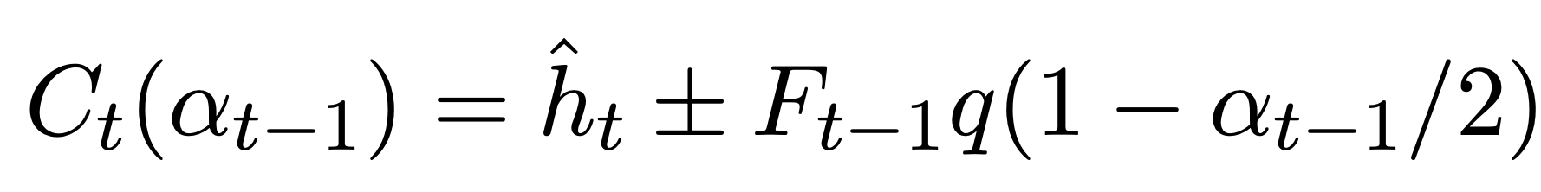
Intervals are built using normality of studentized scores
Since the studentized scores are normal, we can know trivially build a predictive interval for a given confidence level
ex-ante significance level
Forecasted Volatility
Standard Normal Quantile Function

Slide 13
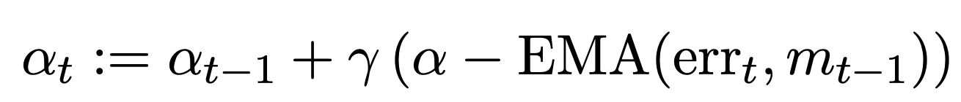
The ex-ante significance level is updated online to match the empirical miscoverage with its target
ACI: Isaac Gibbs and Emmanuel Candes. Adaptive conformal inference under distribution shift. Advances in Neural Information Processing Systems, 34:1660–1672, 2021.

Slide 14
Experiments and Results

Slide 15
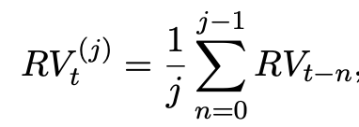
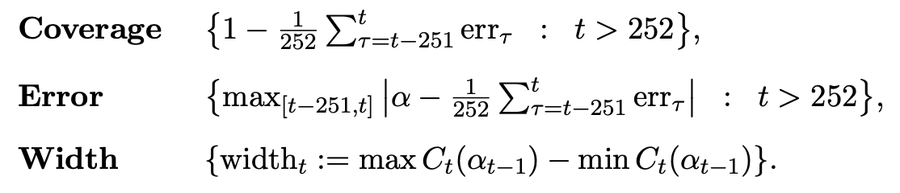
Experiments
Data: http://mba.tuck.dartmouth.edu/pages/faculty/ken.french
10 industry portfolios
Daily equal weighted returns from 1926 to 2023
Forecasting model: HAR
Metrics
HAR: Adam Clements and Daniel PA Preve. A practical guide to harnessing the har volatility model. Journal of Banking & Finance, 133:106285, 2021.

Slide 16
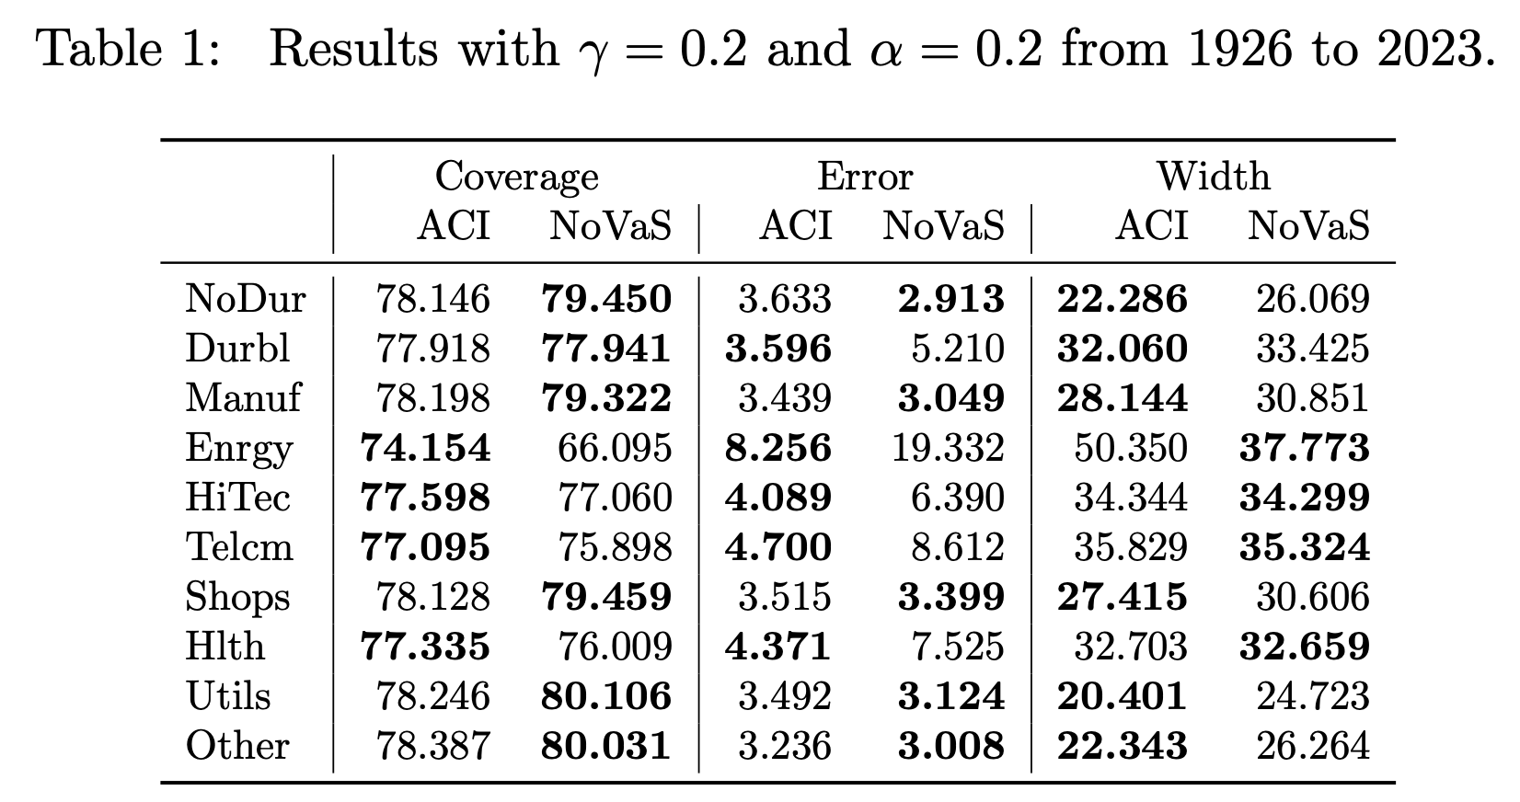
Results

Slide 17
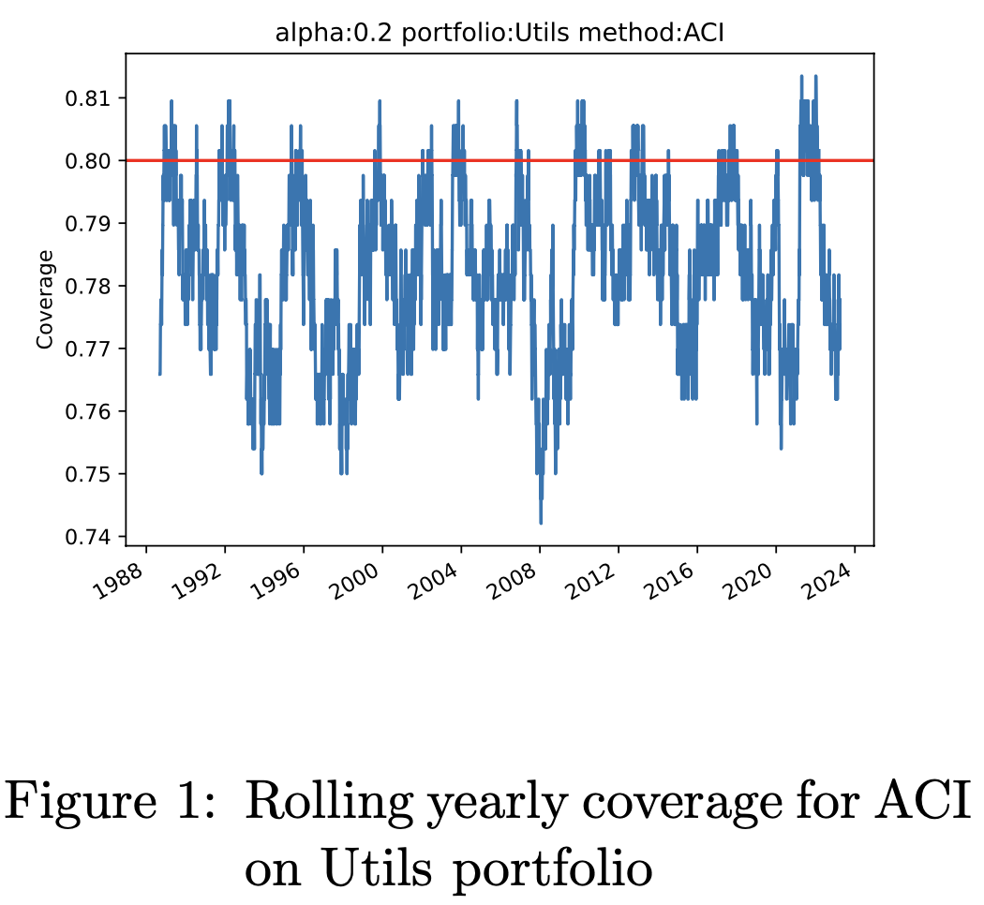
Results

Slide 18
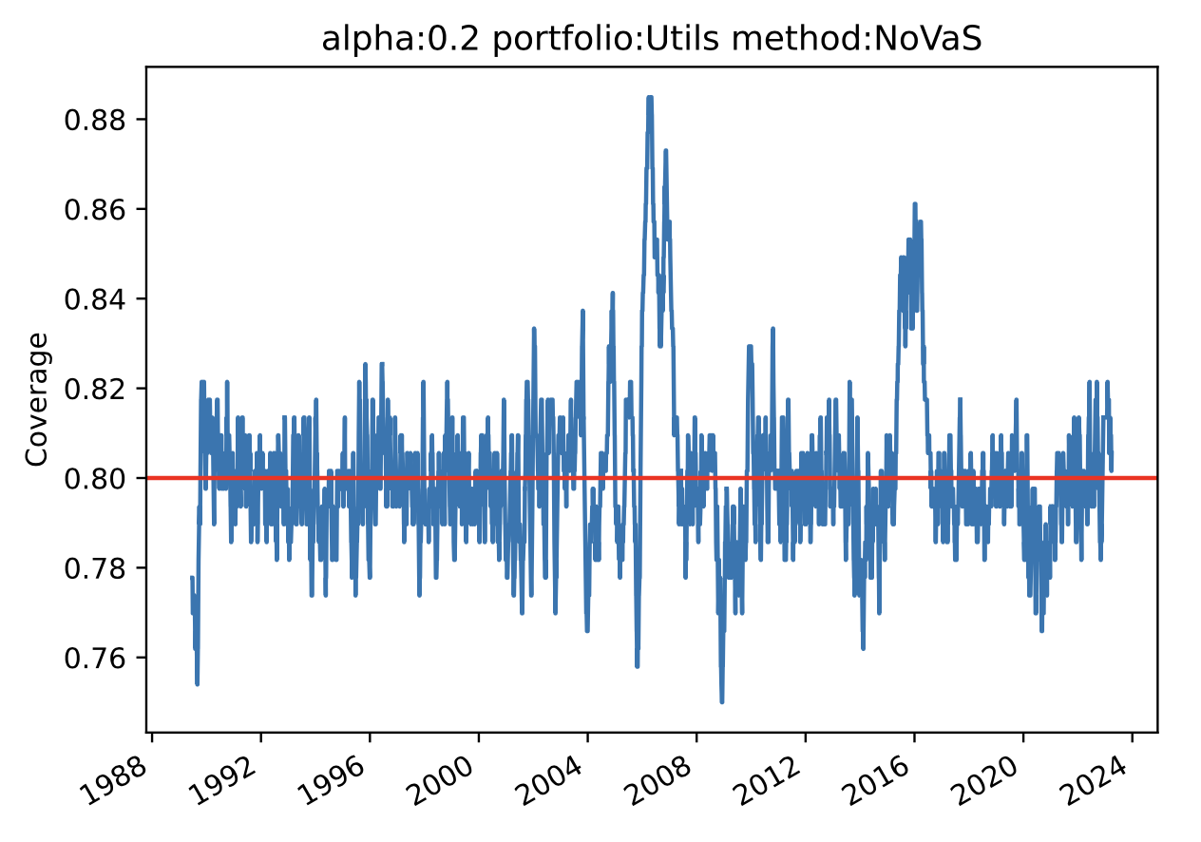
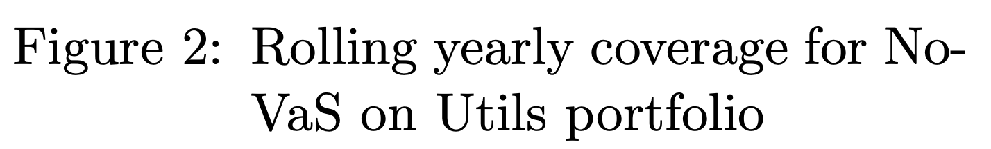
Results

Slide 19
Conclusions and Questions

Slide 20
Conclusions and Questions
Conclusions
Competitive performance (in line with ACI)
On-line setting
Small (bounded) fix memory requirements
Outstanding Questions
Why did performance break with Energy portfolio?
Would this approach work for other financial forecasting use cases?

Slide 21
Thanks!

Slide 22
Appendices

Slide 23
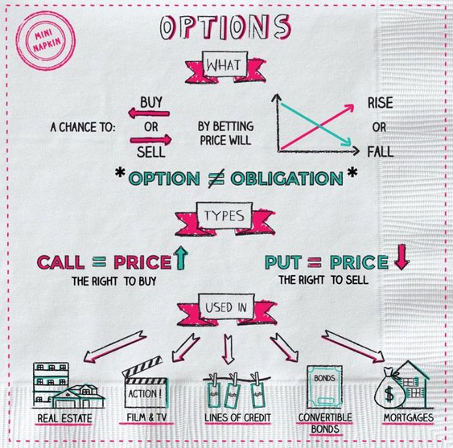
Options : Options provide the right to buy or sell an asset at a given strike price by a certain expiration date
https://napkinfinance.com/napkin/finance-options/

Slide 24
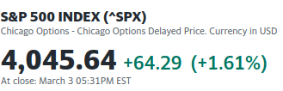
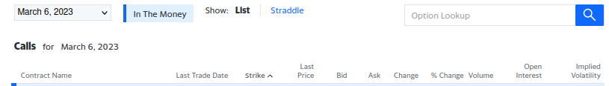
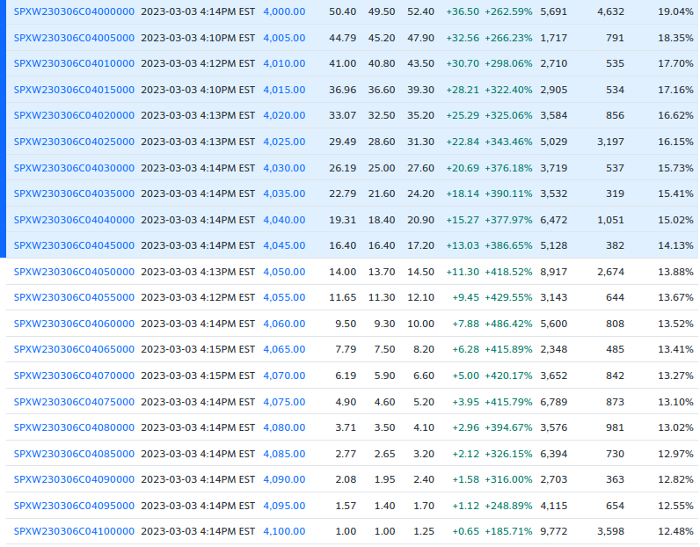
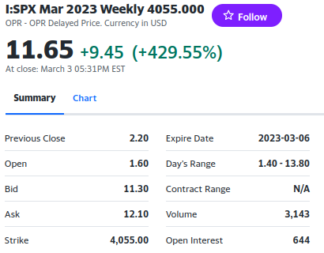
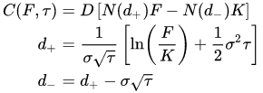

Option Prices and Implied Volatility: Implied volatility is reflected in option prices
https://en.wikipedia.org/wiki/Black%E2%80%93Scholes_model
https://finance.yahoo.com/quote/%5ESPX/options?p=%5ESPX

